Slide 1


Social
Buzz
Report
Notes:
Hello and welcome, my name is Liu Rentong and today I will be presenting to you the results of the Data Analytics task.

Slide 2


Today's agenda
Project recap
Problem
The Analytics team
Process
Insights
Summary
Notes:
Today's agenda will be as follows:
1. We will recap the overall project to give a high level understanding of the business problem we're tackling and the specific requirements.
2. We will dive into the specific problem that we, the Data Analytics team, have been focusing on and will give some background as to why this is such a big problem.
3. After introducing the problem, I will go over the team responsible from our side in tackling this task.
4. I will then go over the high-level process that we followed to complete this task, so that you have complete clarity in how we tackle these kinds of tasks.
5. Finally, I will go over the all important results and I will present them as a series of insights and visualizations from our analysis.
To wrap up, I will summarize and open for any questions.

Slide 3

Social Buzz is a fast growing technology unicorn that need to adapt quickly to it's global scale. Accenture has begun a 3 month POC focusing on these tasks:
An audit of Social Buzz's big data practice
Recommendations for a successful IPO
an analysis of Social Buzz’s content categories in order to highlight the top 5 categories with the largest aggregate popularity
Project Recap
Notes:
To kick things off let me recap this engagement.
We, Accenture have embarked on a 3 month pilot with Social Buzz to focus on 3 main tasks, aligned with some of the biggest challenges that you're currently facing.
Social Buzz has reached huge scale in recent years to become recognized as a global unicorn company. We are here to help you manage this scale and to guide you in the right direction.
Firstly, we will be doing an audit of your big data practice and sharing best practices and industry expertise. Secondly we will be guiding you through a successful IPO, of which we have deep expertise and knowledge of within our team. And finally, we have conducted an analysis of your data to find insights regarding your top 5 most popular categories of content

Slide 4


Problem
Due to the rapid growth and digital nature of Social Buzz’s core product, the amount of data that they create, collect and must analyze is huge.
Every day over 100,000 pieces of content are posted. All of these constitute highly unstructured data that requires expertise in handling.
Social Buzz’s biggest challenge is how to capitalize on this data to gain a deeper understanding of its audience and therefore provide a more personalized and enjoyable experience.
Notes:
Focusing on the last point that I mentioned there, this is what the Data Analytics team has been specifically focused on.
Clearly with such grand scale, this comes with a lot of data and with such vast amounts of data comes challenges.
To give a background on how much data you've been creating:
- You told us that your platform receives over 100000 posts per day which amounts to 36 500 000 posts every year, of which, this is all unstructured data making it very hard to make sense of.
In this day and age, content is king. Just look at some of the biggest platforms in the world, for example YouTube, Facebook and Netflix... they are all content businesses...
But how to capitalize on it when there is so much?
It's not just all about harvesting as much content as possible... The real value is in understanding and crunching this content to gain a deeper understanding of your audience and to therefore provide a more personalized and enjoyable experience.
And this is where out data analytics expertise comes in, with the insights that we've uncovered from this task, we can show you exactly how to take analytics to production at scale.

Slide 5



The Analytics team
Andrew Fleming – Chief Technical Architect, Accenture
Marcus Rompton – Senior Data Expert, Accenture
Liu Rentong– Business Analyst, Accenture
Notes:
Talking about experience, we have a large data analytics practice at Accenture but we had a team of 3 people primarily focusing on this task. Andrew Fleming is our Chief Technical Architect and his expertise really helped to guide the team to produce high quality analysis.
Marcus Rompton, a senior data expert has worked with the worlds biggest clients on solving their data problems and was heavily involved in the data engineering side of this project.
And finally myself, Liu Rentong, who was solely responsible for taking leadership guidance and delivering high quality insights from the raw datasets and turning these into business decisions.

Slide 6
Process
1
Data Understanding: Understand the data model and domain of your business
2
Data Extraction: Architected what an ideal dataset should look like for this problem and extracted it from the relevant data sources
3
Data Modelling: Process and model the data into a dataset that can precisely answer the business questions and produce analytics.
4
Data Analysis: Use analytical expertise to uncover insights from the dataset and to produce visualizations to describe the insights.
5
Recommendations: Use insights to unlock business decisions and make recommendations on next steps
Notes:
So, how did we tackle this problem?
Well, we approached it in 5 steps:
1. Data understanding - the key to success on any data project is to understand the data in detail. So we took the time to understand the data model and domain of your business.
2. Data extraction - after understanding your business, we then architected what an ideal dataset should look like for this problem and extracted it from the relevant data sources.
3. After extracting the raw data, we needed to process and model this data into a dataset that can precisely answer the business questions and produce analytics.
4. With our new dataset, we used our analytical expertise to uncover insights from this dataset and to produce visualizations to describe the insights.
5. And finally we used these insights to unlock business decisions and to make recommendations on next steps.

Slide 7
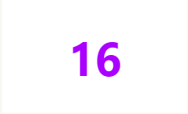
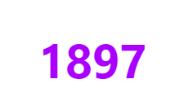


Insights
Distinct Content Categories
Month with most Posts
Animal Posts
Notes:
From your data we found that you had a total of 16 unique categories of posts across your sample dataset. This includes things such as Food, Culture and Sport.
As well as this, there was 1897 posts from just the Animals category alone! People obviously really like animals!
And also the most common month for users to post within was January, since this is such a seasonal month with so many holidays and events, this is interesting to know that people are most active during this month!
But now, onto the main question... which is... what were the top 5 most popular categories of posts?

Slide 8
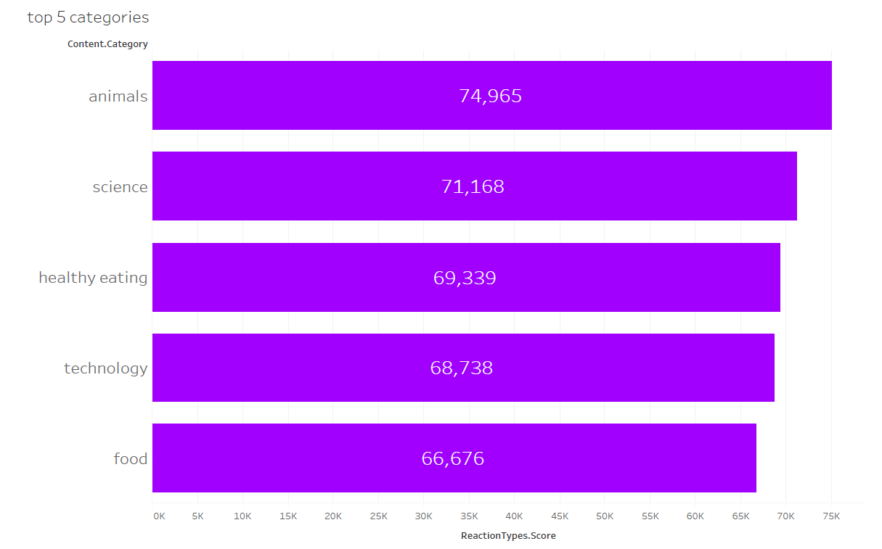
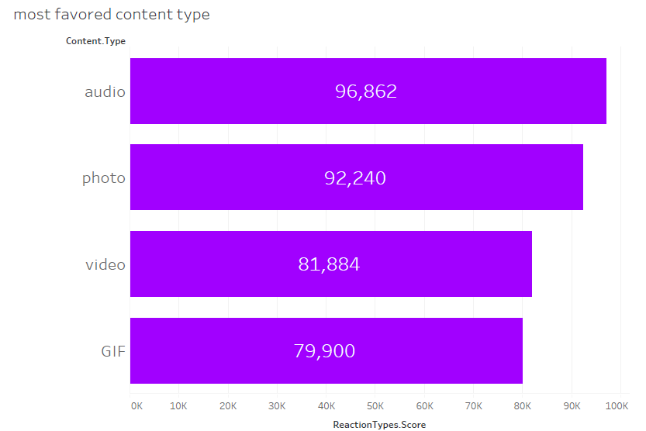
According to our analysis, the top 5 content categories (ranked by popularity score) are Animals, Science, Health Eating, Technology, and Food in descending order.
For the top 5 categories, Audio is the most favored content type. This could indicate that users engage with this content on a recreational learning level.

Slide 9
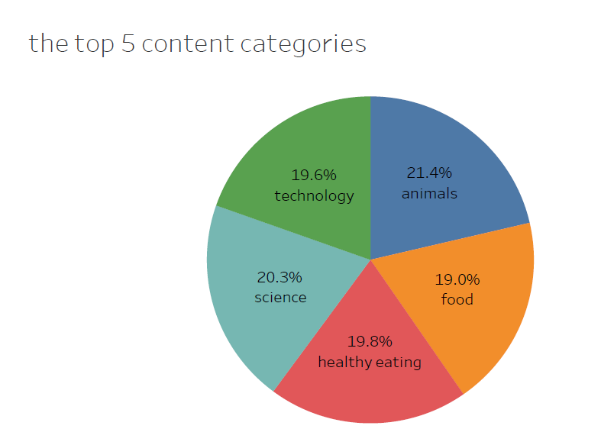
Additionally, you can see from this chart the % split of popularity between the top 5 categories. There is not much difference between each of them, animals outperforms science by 1.08%, healthy eating outperforms food by 0.76%, and science outperforms technology by 0.69%.
It is therefore highly likely these categories are intertwined with one another.

Slide 10

Animals and Science are the two most popular content categories indicating an innate tendency to seek connections with nature and facts.
Healthy eating and food fall in the top 5 category. This may give an indication to the audience within your user base. This is a broad indication of an audience within Social Buzz’s user base. You could use this insight to create a campaign and work with healthy eating brands to boost user engagement.
Summary
Social Buzz can leverage holiday seasons to boost growth and user engagement with the “nature” content category via relevant social media strategies.

Slide 11

Thank you!
ANY QUESTIONS?
Notes:
Thank you very much for listening, please feel free to ask any questions that you may have!

